Slide 1
Mobile controlled home
01
Description
A brief of what smart home systems contain and the structure contained inside of them
02
System structure
Full description of smart home system structure and how it’s concatenated, connected, interacted with its internal separate structures.
03
Hardware components
Presents components used to make the system available in hardware besides a code to interface different components together
04
references
Data sheets

Slide 2

A smart home is a relation between users and IOTs. This relation can be summed up using operations like; adding new users in the system, controlling doors, lights or any IOT that can be controlled.
So many options and operations can be performed and added to the current implemented system including the use of RFID to automate the process of adding new users, searching for members, finding a user’s password etc..

Slide 3
System Structure
Contents
Works as an input for the system
Structure for members’ operations
ATMEGA32 - AVR MICROCONTROLLER
BLUETOOTH
Members Structure
LCD
SYSTEM
Displays output for the system
System is alive and interactive with external peripherals and its internal structures

Slide 4
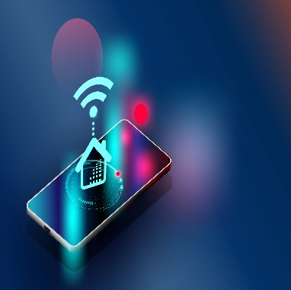


System Structure
Insert member
10 or more users
By including Member’s name and his password you are done with insertion.
This system works for only 10 users, however this number can be increased to which ever the buyer want.
Show all members
Delete a user
All members are shown by using a list contains every member in the system. Admin privileges is required.
Deleting a member is done by specifying his name in the memory and this feature can only be accessed by admin user only.
Auto checking for memory errors
In some cases the user can terminate a program at any stage of the mobile application. For every application’s new start an auto validation for data in memory is done.
Control for systems
Every user in the system has the same access with same authorizations except for an admin user which is specified by the manufacturer.

Slide 5

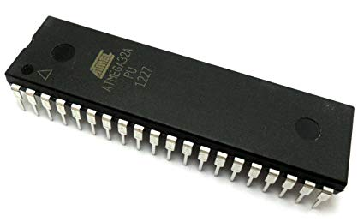
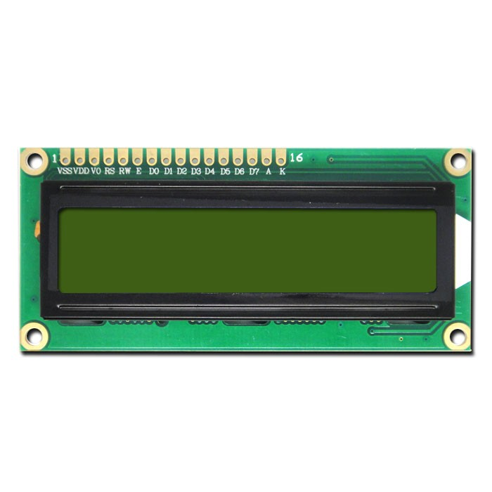
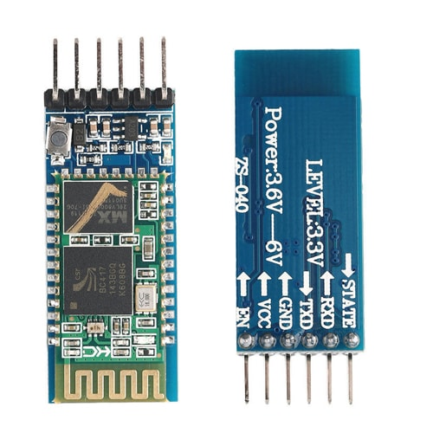
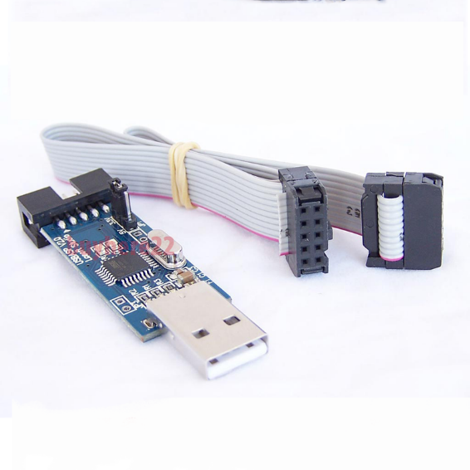
Servo motor
ATMEGA32
LCD
Bluetooth
USP- ASP
COMPONENTS

Slide 6
Thank You
Insert the Sub Title of Your Presentation

Slide 7
Fully Editable Icon Sets: A

Slide 8
Fully Editable Icon Sets: B

Slide 9
Fully Editable Icon Sets: C

